Slide 1
Global Superstore
Dashboard
Sales Report for the year

Slide 2

Key Performance Indicator (KPI)

Slide 3
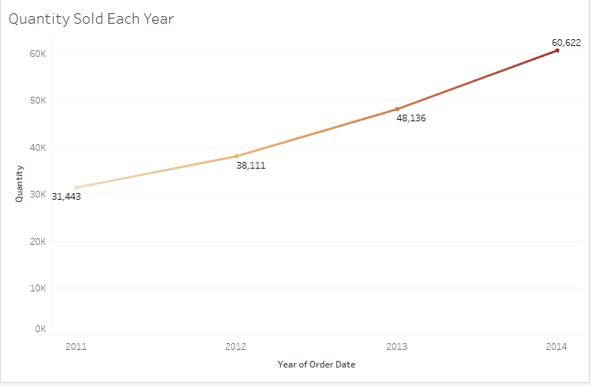
Quantity Sold for Each Year
The trends of the total quantity sold for each year by the company

Slide 4
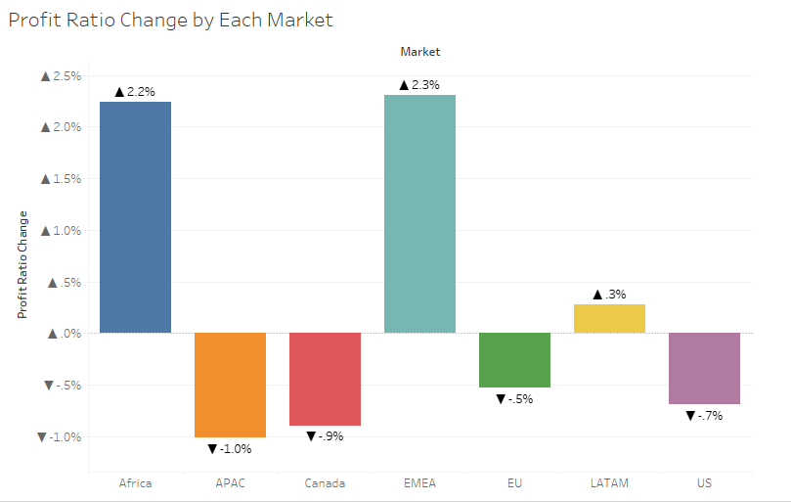
Profit Ratio Change by Each Market
Comparing the profit ratio change between the prior year and current year to know if we are on the positive side of the market or losing side of the market.

Slide 5
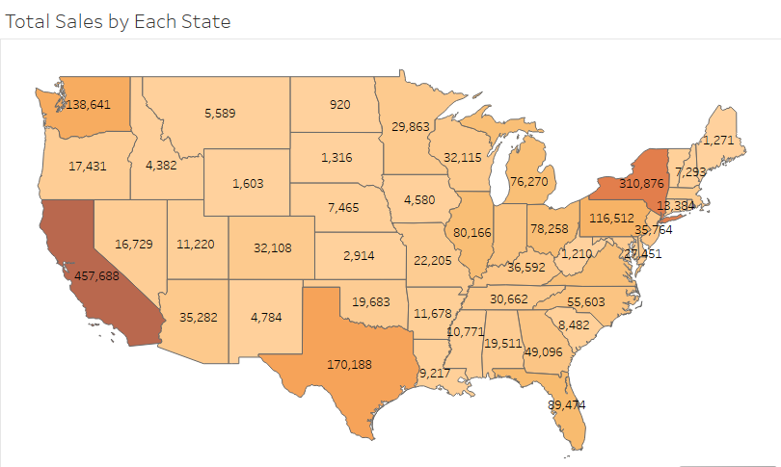
Total Sales by State
Total Sales by State helps us know the states that buy more of our products and the one with the lowest number. In this analysis, California happens to be the best state with total Sales of $457,688 while North Dakota is the least with total sales of $920

Slide 6
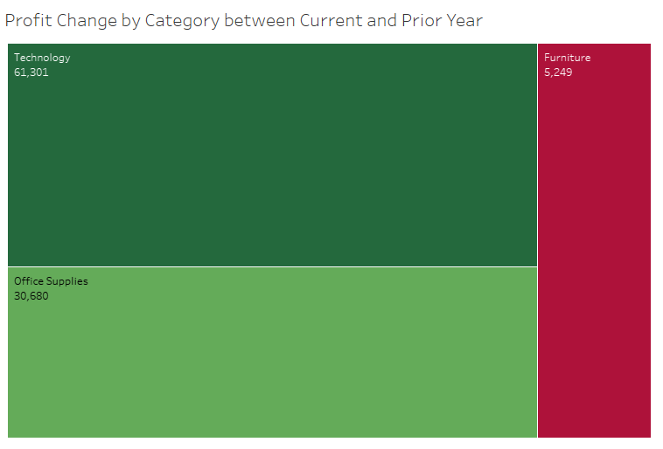
Profit Change by Category between the Current and Prior Year
This chart helps the company to know if we made more sales the year compared to last year and if there a large improvement of sales between the two years

Slide 7
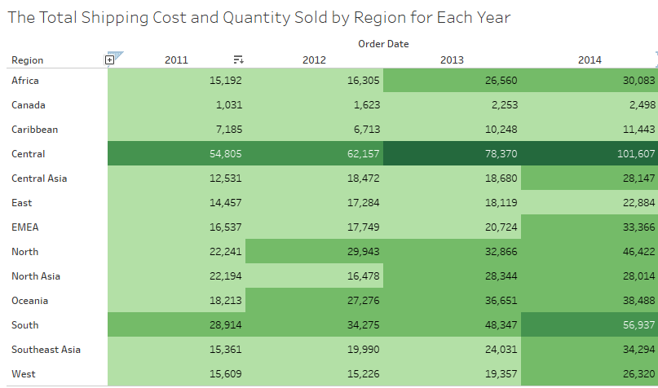
Total Shipping Cost and Quantity Sold by Region for Each Year
This helps the company to know each amount we spend on shipping products to different region and the region with the highest order per year.

Slide 8
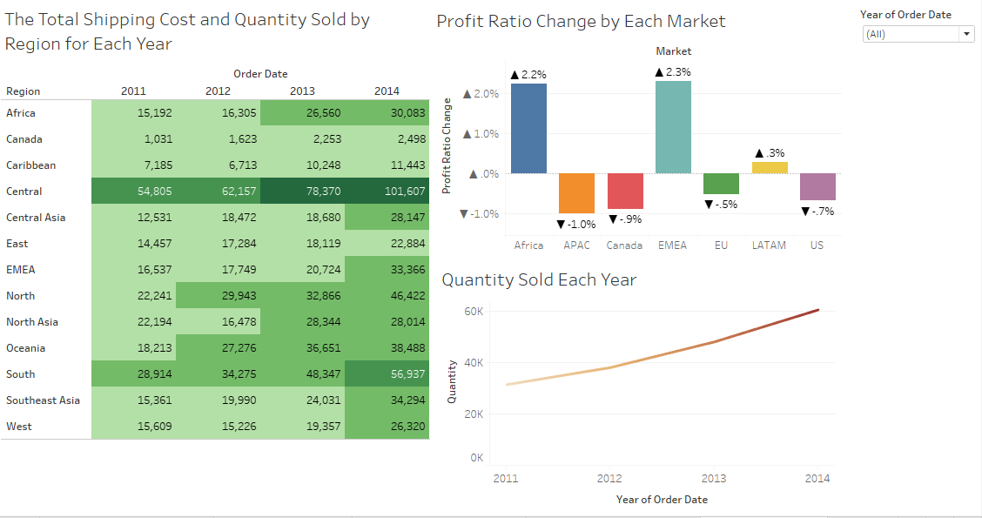
A Dashboard for the Analysis

Slide 9
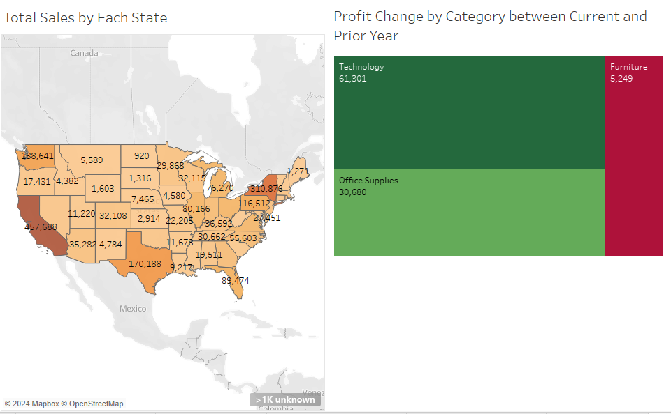
A Dashboard for the Analysis 2.

